Slide 1
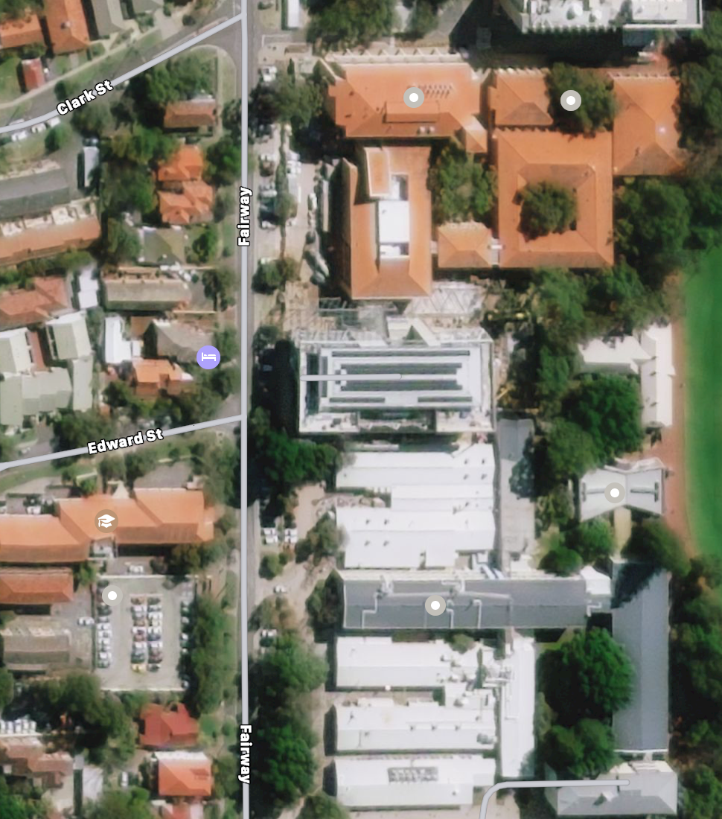
PhD Lab EE3.11
Prof. Office EE4.15
Industrial Robots
EZONE Central G.05
Clough Robotics Lab
REV Lab Mech G.25

